Slide 1
Learning on Graphs with Bracket-Based Dynamical Systems
Sandia National Laboratories is a multimission laboratory managed and operated by National Technology and Engineering Solutions of Sandia LLC, a wholly owned subsidiary of Honeywell International Inc. for the U.S. Department of Energy’s National Nuclear Security Administration under contract DE-NA0003525.
SAND2024-15333O
Anthony Gruber¹, Kookjin Lee², Nat Trask³
¹Sandia National Laboratories, ²Arizona State University, ³University of Pennsylvania
Notes:
Sandia National Laboratories is a multimission laboratory managed and operated by National Technology and Engineering Solutions of Sandia LLC, a wholly owned subsidiary of Honeywell International Inc. for the U.S. Department of Energy’s National Nuclear Security Administration under contract DE-NA0003525

Slide 2
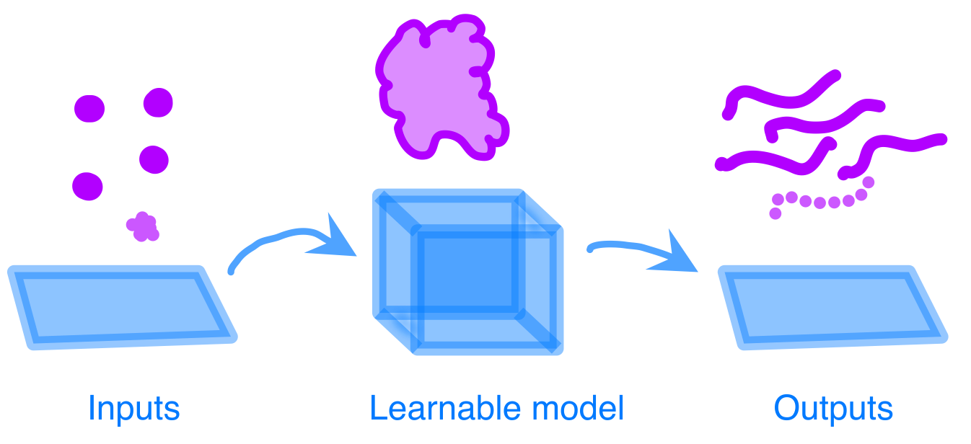
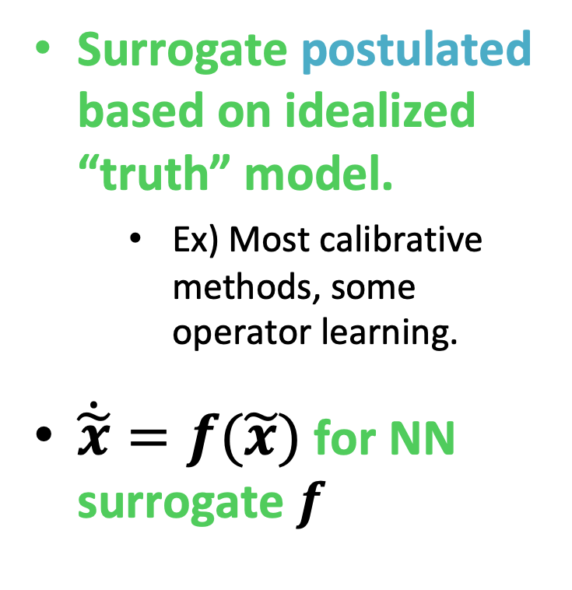
“Bottom-up” Surrogates
Presenter name: Title of presentation
Surrogate postulated based on idealized “truth” model.
Ex) Most calibrative methods, some operator learning.
$\dot{\tilde{x}}=f(\tilde{x})$ for NN surrogate $f$

Slide 3
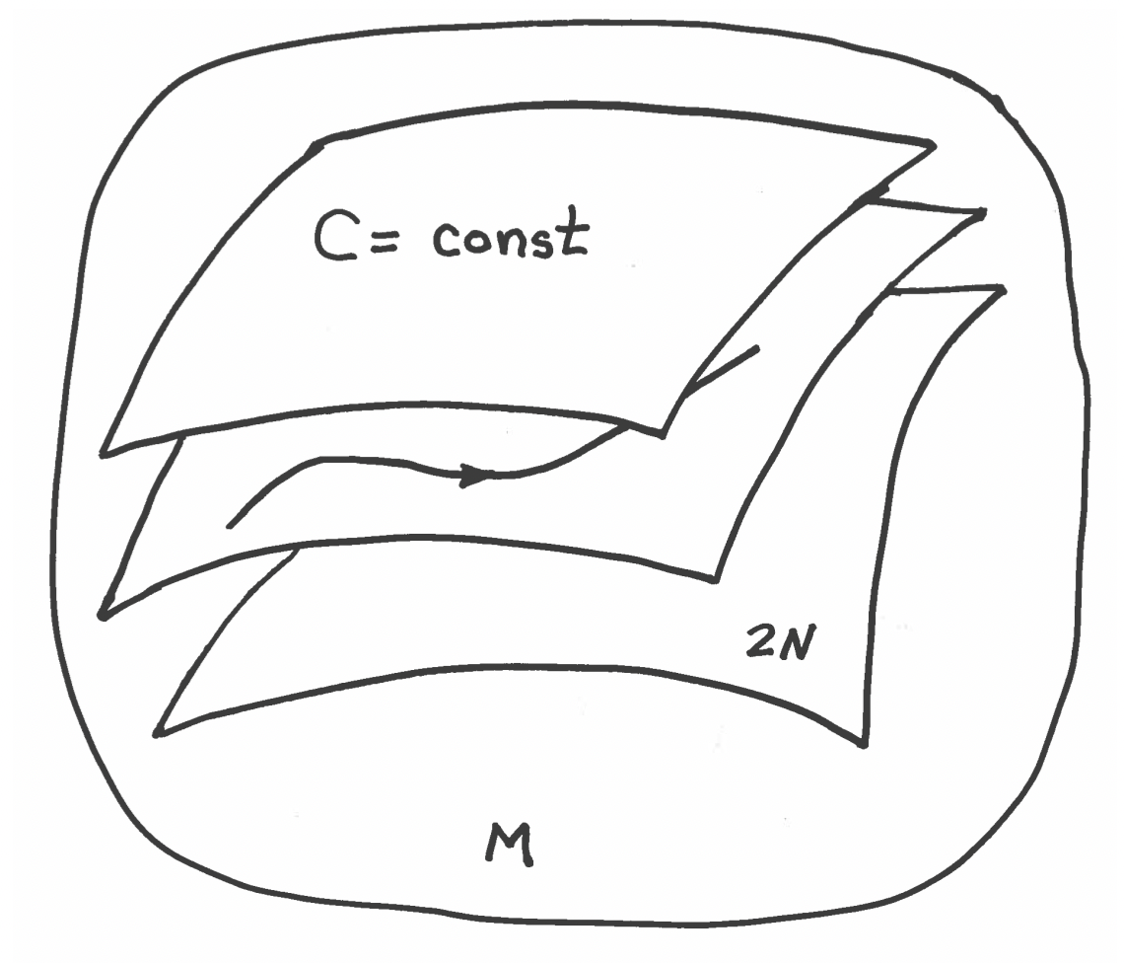
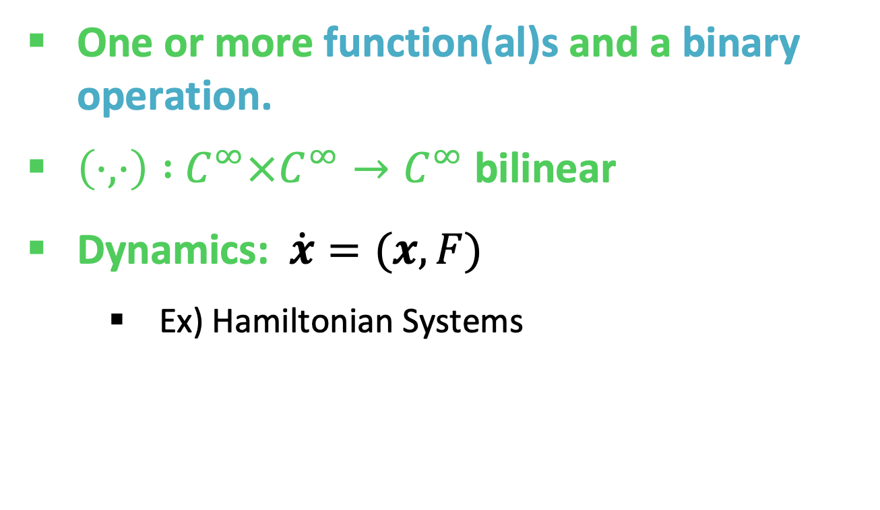
Bracket-Based Dynamical Systems
Presenter name: Title of presentation
One or more function(al)s and a binary operation.
$\left(⋅,⋅\right) :{ C}^{∞}×C^{∞}→C^{∞}$ bilinear
Dynamics: $\dot{x}=(x, F)$
Ex) Hamiltonian Systems
Illustration courtesy of J. Burby & P. J. Morrison

Slide 4

Bracket-Based Dynamical Systems
Presenter name: Title of presentation
barrier
Add dissipation to Hamiltonian or Lagrangian systems.
Need two thermodynamical laws…
Ex) Metriplectic Systems
dissipation

Slide 5
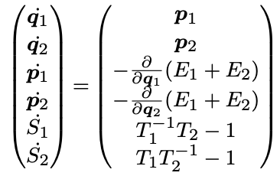
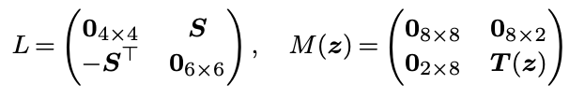
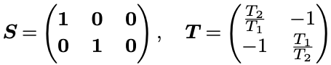
Example) Thermoelastic Pendulum
Presenter name: Title of presentation
State variable
Energy/Entropy:

Slide 6
What’s Needed for Metriplecticity?
Presenter name: Title of presentation
We want energy conservation and entropy generation.
Solution? Prescribed degeneracies!
Can enforce
0

Slide 7
Does This Actually Matter?
Presenter name: Title of presentation
A. Gruber et al., “Energetically consistent model reduction for metriplectic systems”, CMAME 2023

Slide 8
Does This Actually Matter?
Presenter name: Title of presentation
A. Gruber et al., “Energetically consistent model reduction for metriplectic systems”, CMAME 2023

Slide 9
Example) Thermoelastic Pendulum
Presenter name: Title of presentation
State variable
Energy/Entropy:
Can we discover a metriplectic system?
With three nodes and two edges.
Which approximates the double pendulum?

Slide 10
Graph Exterior Calculus
Presenter name: Title of presentation
Graph
Nodes, edges, arbitrary orientation
Higher-order cliques

Slide 11
Structure-Preserving GNN Model
Presenter name: Title of presentation
Formulated a GNN model from bracket-based dynamical systems
A. Gruber, K. Lee, N. Trask, “Reversible and Irreversible Bracket-Based Dynamics for Deep Graph Neural Networks”, NeurIPS 2023.

Slide 12
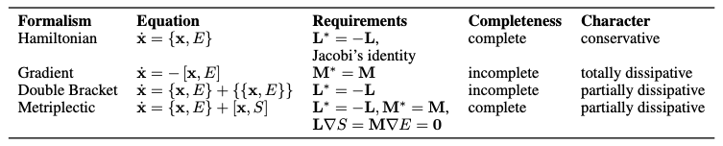
Structure-Preserving GNN Model
Presenter name: Title of presentation
Features are discovered
Learnable linear or message-passing autoencoder
Brackets are designed
Four cases with specific forms

Slide 13
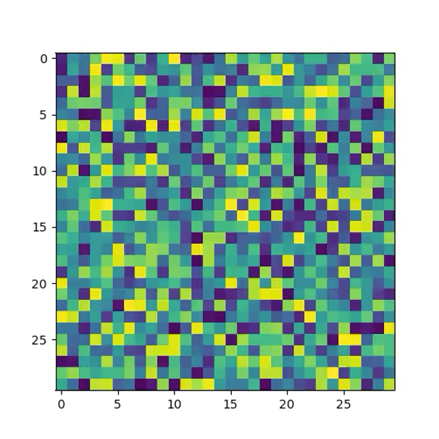
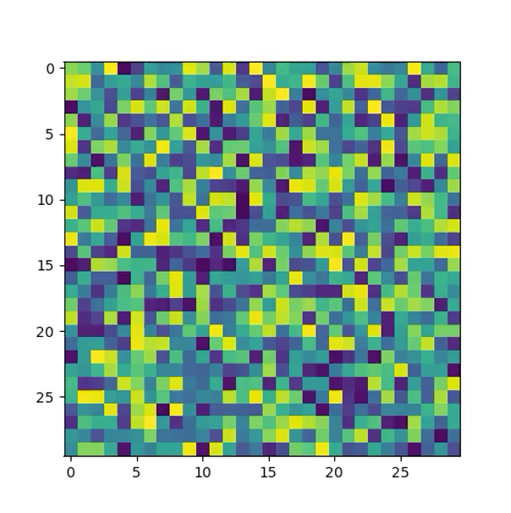
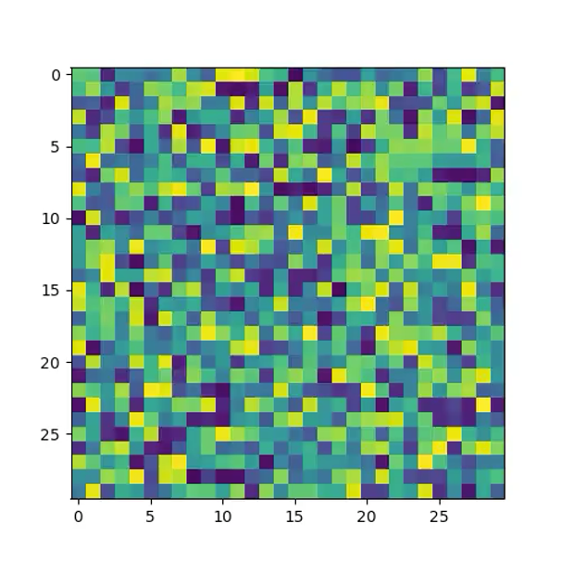
Example Evolutions
Presenter name: Title of presentation
Hamiltonian Metriplectic Gradient

Slide 14
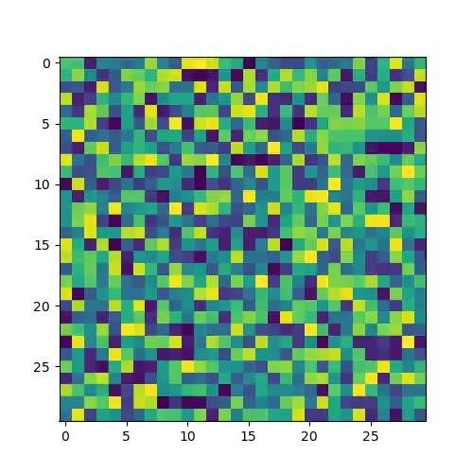
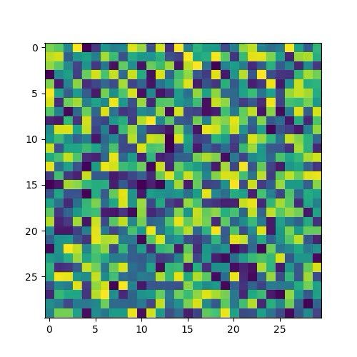
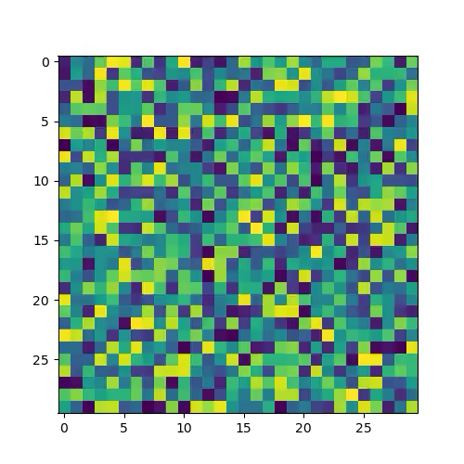
Example Evolutions
Presenter name: Title of presentation
Hamiltonian Metriplectic Gradient

Slide 15
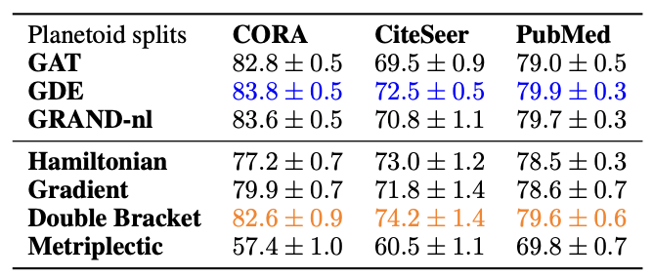
Applications
Presenter name: Title of presentation
Yields provably metriplectic surrogates with linear scaling in # nodes/edges!
Bracket-based evolution guarantees stability of network propagation
“Science4AI” applications:

Slide 16
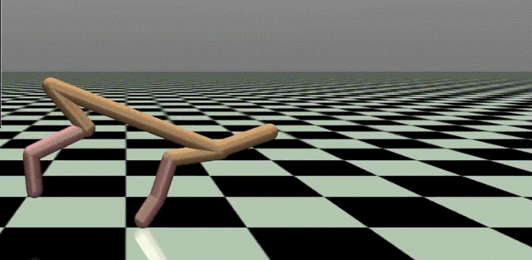
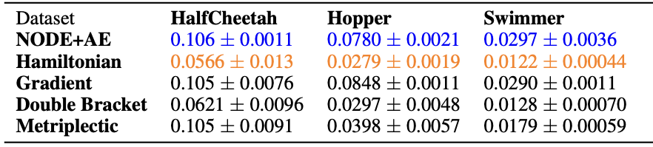
Applications
Presenter name: Title of presentation
Jiazheng Chai et al. Motor Synergy Development in High-Performing Deep Reinforcement Learning Algorithms, IEEE Robotics and Automation Letters (2020). DOI: 10.1109/LRA.2020.2968067
https://www.gymlibrary.dev/environments/mujoco/half_cheetah/

Slide 17
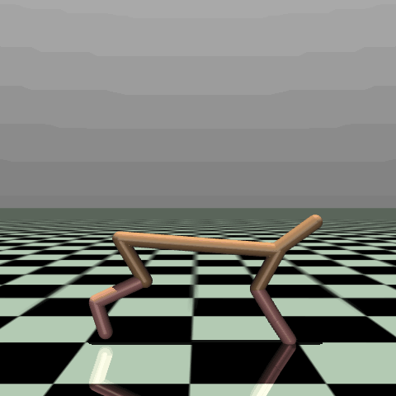
Applications
Presenter name: Title of presentation
Jiazheng Chai et al. Motor Synergy Development in High-Performing Deep Reinforcement Learning Algorithms, IEEE Robotics and Automation Letters (2020). DOI: 10.1109/LRA.2020.2968067
https://www.gymlibrary.dev/environments/mujoco/half_cheetah/
https://www.gymlibrary.dev/environments/mujoco/half_cheetah/

Slide 18
Looking Forward
Presenter name: Title of presentation
Follow-on work extended off-graph to general metriplectic systems
Comes with universal approximation and generalization bounds.
Would like to combine approaches
Can we get a metriplectic GNN which is general on a given graph?
A. Gruber, K. Lee, H. Lim, N. Park, N. Trask, “Efficiently Parameterized Neural Metriplectic Systems”, submitted to ICLR 2025.

Slide 19
Looking Forward
Presenter name: Title of presentation
Currently collaborating with CHaRMNET MMICC
Aim to combine NMS with tLAsDi
Ongoing collaborations with ASU, UPenn, KAIST, LLNL, NCSU
A. Gruber, K. Lee, H. Lim, N. Park, N. Trask, “Efficiently Parameterized Neural Metriplectic Systems”, submitted to ICLR 2025.

